Slide 1
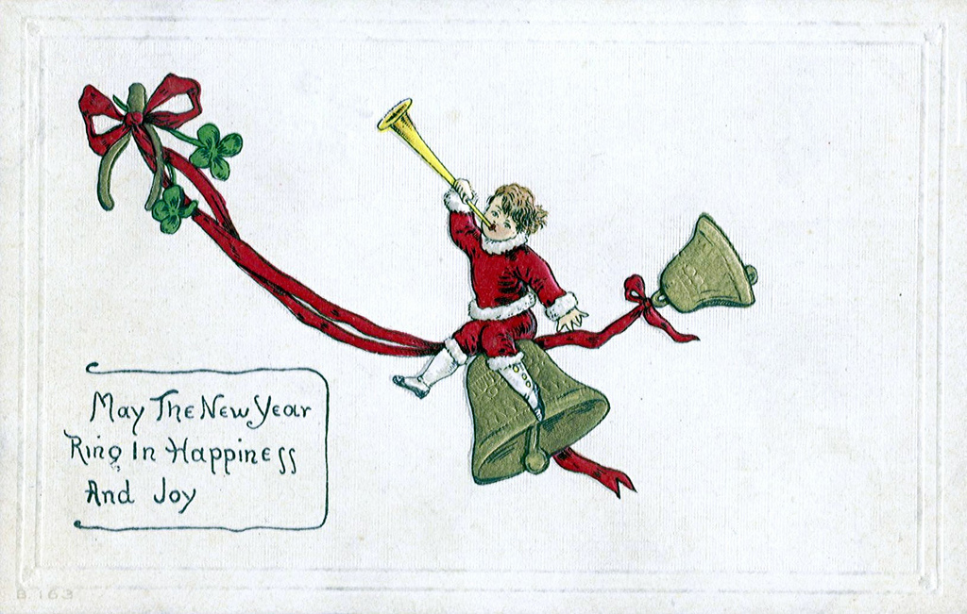
MAY’S SLOT
Autumn is on the wane, bringing with it, it’s fallen leaves, making a carpet of that magnificent variegation, of yellow, gold, brown on a background of bright green. This is what I see from the window of my cosy room in Valentia.
Summer is long gone, not to arrive for another year. First now it is replaced by dripping roofs and almost naked trees. Still we look back with gratitude for June, July and August which brought many treats. The trip to Wells House and its beautiful gardens was much appreciated, while an afternoon of social gathering and the enjoyment of whipped ice cream in pleasant company were two special pleasant days. Most of us sat chatting in the shade while children ran around from one to the other with mouth watering cones, bringing back memories of the days when we were all young.
Halloween was a time of fun. Children and some of the staff came around wearing masks and making us laugh. I pretended to be frightened and the children were pleased with that.
Now Christmas is our next landmark-The biggest and most important birthday of the year.
The imagination sometimes runs away with me and I picture us believers, all sitting around a huge table with the Birthday Boy at the head. The table is covered with all types of delicacies and decorations and colourful flowers. Very few of us speak to our host because we are too busy exchanging gifts, but not a card or present for our host. He is ignored except when we sing carols to entertain him. You see many people forget the origin of Christmas.
Months beforehand cakes and puddings are made, Santa’s presents are parcelled up and hidden from wandering little eyes. The little ones are taken out to Santa to receive gifts from him in advance. The adults become foot-sore and weary from shopping. Love is in the air and once December comes there is an atmosphere of joy and expectancy.
The days pass slowly while parcels of good things are prepared for the poor and unfortunate so that they may have at least a special day.
Just like every other event in life, Christmas time comes to an end and we look ahead to a new year in hope it may bring peace and harmony, which we all want and for which we as Christians pray, and why not, if we are to follow Christ our Prince of peace, after whom we are named.
RESIDENTS MEETING
The meeting took place in September and a copy of the minutes are displayed on the Residents Notice board outside the Library. Next one to be held in March 2019.
END OF SUMMER FUN
This took place in September and was lots of fun.
Valentia
Nursing Home
WINTER Newsletter 2018
HAPPY CHRISTMAS TO ALL AND HAVE A SAFE AND HAPPY 2019!
From kieran, Caroline, Billy, Claire & all the staff.
For forthcoming events for the festive season see the residents notice board or our website.

